Slide 1
DigiWallet Your documents Anytime, Anywhere
Nishtha Chawla
Ravneet Kaur

Slide 2
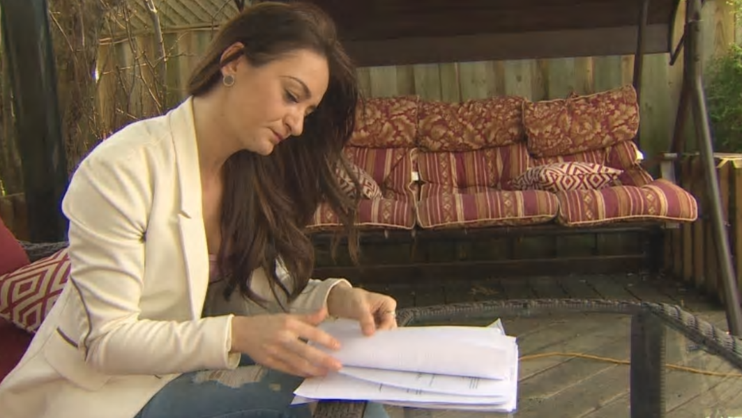
Notes:
Problem
Src: https://www.cbc.ca/news/canada/toronto/woman-missed-out-on-job-because-canada-post-lost-mail-not-once-not-twice-but-3-times-1.4645548

Slide 3
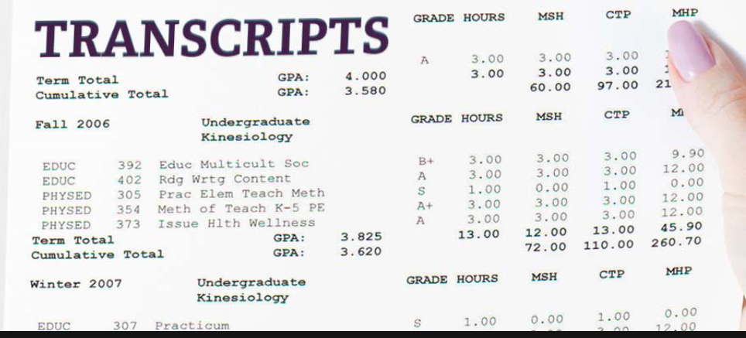
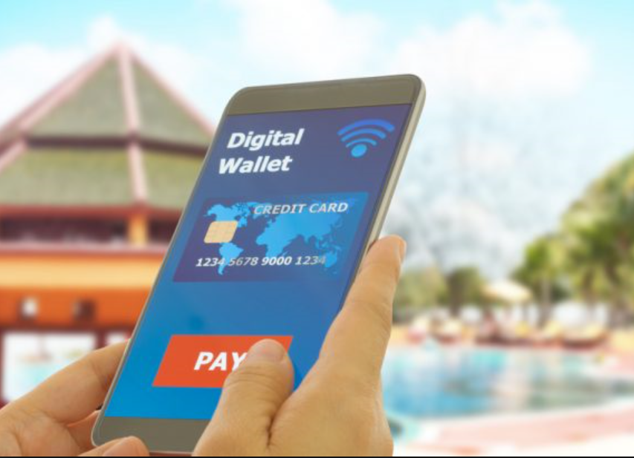
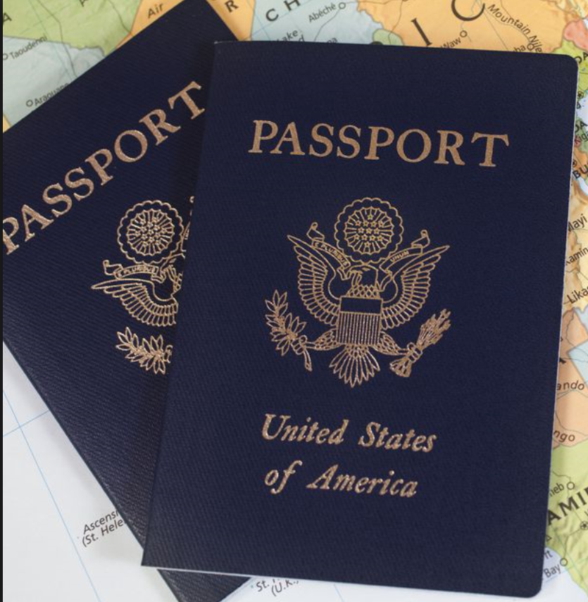
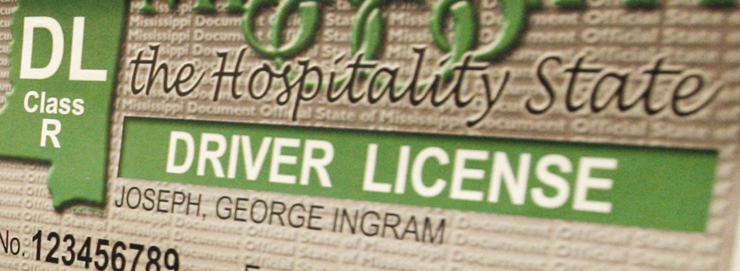
DigiWallet
Notes:
Solution

Slide 4







How DigiWallet Works?
CITIZENS
ISSUE DOCUMENTS DIGITALLY
ACCESSES DOCUMENTS ONLINE
ISSUER
DigiWallet
REQUESTER
Notes:
Product

Slide 5



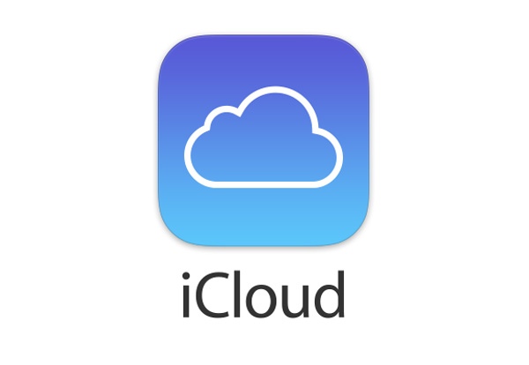

Other Key Players
Notes:
There are several other key players in the market like Dropbox, Amazon cloud, one drive.
All of these substitutes provide file hosting service but none of the documents come from any legitimate issuers.
But we stand out as the DigiWallet will hosts officially acceptable identity docs.

Slide 6


Competitive Advantage
 | Google Drive | One Drive | iCloud | Amazon Cloud | DigiWallet
Client-Side Encryption
HTTPS
E-Sign Documents
Android/ iOS
Shared file Expiry Date
File History/ Versions | Unlimited | Unlimited | Unlimited | Unlimited | Latest Version
Password Protection of Shared File
Notes:
The documents stored and transmitted over the internet will be encrypted.
Also, the issuers of the documents can set the expiry date for the documents.
And the issuers will be able to create a password protected file to avoid unauthorized access.

Slide 7
Market Size
Smartphone and Internet users in Canada
UBC Students
Students of Lower Mainland
60K
300K
26.6 Million
SOM
SAM
TAM
Notes:
We will initially launch Digiwallet in UBC and in the next phase we plan to reach all the post secondary students in lower mainland. This product has a potential to scale nationally to include all smartphone users as we can then bring banking and other institutions on board

Slide 8
Business Model
ccc
90K
40$
$3.6M
30% SAM
Average Fees
REVENUE
Notes:
At a minimum, we aim to capture 30% of the SAM which is approximately 90K students, with 40$ annual fees of our product, we can generate 3.6Million in revenue.

Slide 9
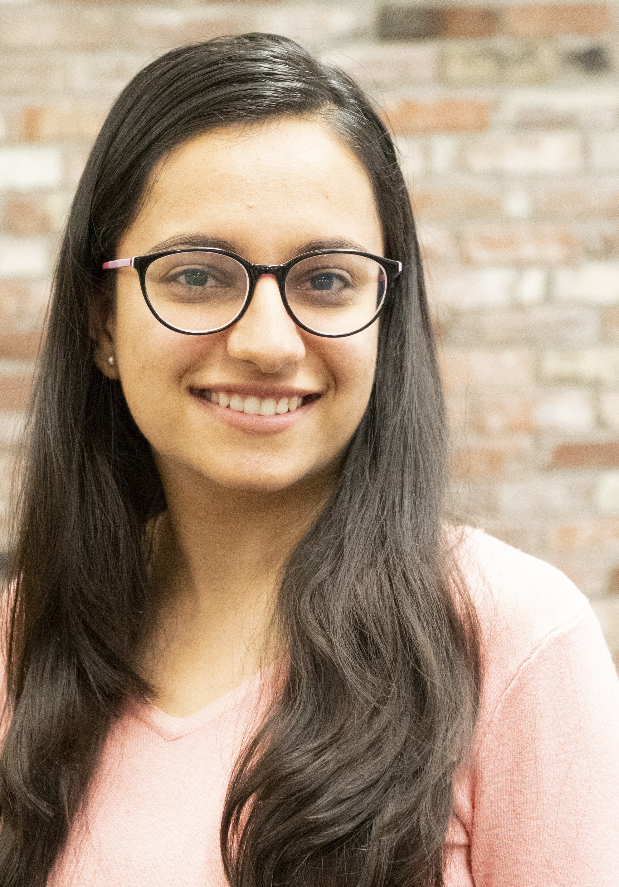
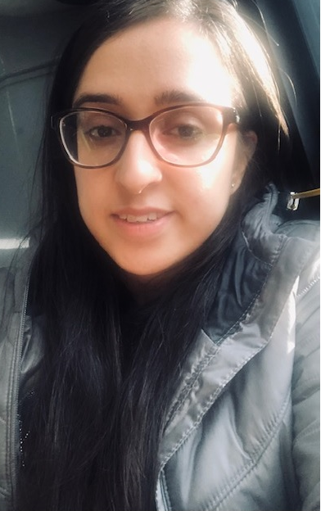

OUR TEAM
Nishtha Chawla
Founder
Engineer
Ravneet Kaur
Founder
Engineer
Finance Analyst
Co-Founder
Business Strategist
Co-Founder
Notes:
As of now, our team consists of two of us as the founders and engineers of the DigiWallet.
And we are looking for a finance analyst and a business strategist to fill the gaps in our team.
The ultimate aim of DigiWallet is to eliminate hassle associated with losing of documents and reducing the replacement cost for consumer and printing cost for the government. And to help people like Aleksandra to not lose job offers because of misplaced documents.

Slide 10
Replacement Fee
Passport 45$
License 17$
BCID 15$
Transcript 10$

Slide 11
Revenue
SOM - 57486
Capture 50% = 28743
40 % transaction package customers: 11500
Rate for product 8$ valid for 90 days ( 3 months)
=92,000$
Revenue for 6 months: 184000$
60% subscription package customers: 17200
Rate for product: 25$ half-yearly package
=430,000$
Total revenue =614,000$ 6 months in UBC
International students: 18000
Capture rate: 50 %- 9000

